Slide 1
W4111 – Introduction to Databases Section 002, Spring 2021 Lecture 3: ER, Relational, SQL (III)
© Donald F. Ferguson, 2021

Slide 2
W4111 – Introduction to Databases Section 002, Spring 2021 Lecture 3: ER, Relational, SQL (III)
We will start in a couple of minutes.
© Donald F. Ferguson, 2021

Slide 3

Contents
3 | COMS W4111_002_2021_1: Lecture 3: ER, Relational, SQL (III) © Donald F. Ferguson, 2021

Slide 4
Contents
Introduction: comments, questions and answers
Relational Model, Relational Algebra (Completion)
Intermediate SQL
Intermediate ER Modeling and SQL Realization
Class Project/Homework Directions/Discussion
I will cover in recitation.

Slide 5
Questions, Answers, Comments
5 | COMS W4111_002_2021_1: Lecture 2: ER, Relational, SQL (II) © Donald F. Ferguson, 2021

Slide 6
Homework 1 – “Getting out over the skis”
Change in Spring ‘21 course approach based on student feedback:
I previously expected students to self-learn SQL, and other concepts.
Lots of material in book, tutorials, etc.
Listening to some present slides is not a good approach.
You learn by practice, doing, ... ...
My lecture focus was on topics that you cannot easily learn from books, tutorials, ... ...
End Fall ’20 student feedback expressed dissatisfaction with the approach. Lecture material was not covering homework material.
I am pivoting to better cover SQL, core concepts, etc.
We did not adequately factor the change in direction into HW 1.
I go through homework problems in recitations.
Any code that I write is a “hint” or “directional guidance.”
Please do not expect to simply transcribe what I type, expect it to work, and then ask me to fix it for you if it does not.

Slide 7
Piazza Questions
Switch to Jupyter Notebook

Slide 8
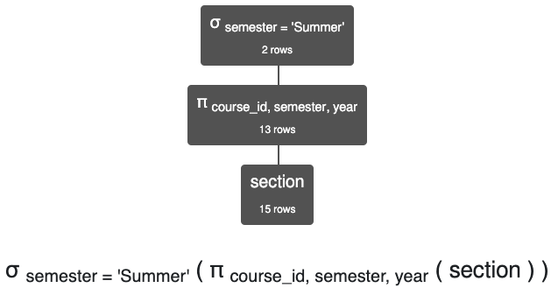
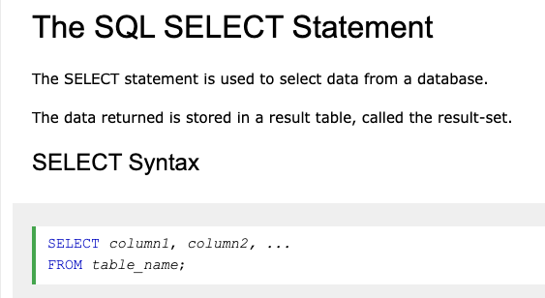
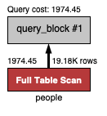
Result Tables; Derived Tables
https://www.w3schools.com/sql/sql_select.asp
Result Table
Derived Table
Base Table
Result Table
Operation
Base Table
Nodes represent relational operations.
Arrows represent flow of tables.
Not exactly what the diagram means but it explains the concepts.

Slide 9
The Relational Model
9 | COMS W4111_002_2021_1: Lecture 2: ER, Relational, SQL (II) © Donald F. Ferguson, 2021

Slide 10

The Relational Data Model (Completed)
10 | COMS W4111_002_2021_1: Lecture 2: ER, Relational, SQL (II) © Donald F. Ferguson, 2021

Slide 11
Relational Algebra
11 | COMS W4111_002_2021_1: Lecture 2: ER, Relational, SQL (II) © Donald F. Ferguson, 2021

Slide 12
Relational Algebra
A procedural language consisting of a set of operations that take one or two relations as input and produce a new relation as their result.
Six basic operators
select: σ
project: ∏
union: ∪
set difference: –
Cartesian product: x
rename: ρ
intersect
← assignment
Last Lecture

Slide 13
Composition of Relational Operations
The result of a relational-algebra operation is relation and therefore of relational-algebra operations can be composed together into a relational-algebra expression.
Consider the query -- Find the names of all instructors in the Physics department.
∏_{name}(σ _{dept_name} _{=“Physics”} (instructor))
Instead of giving the name of a relation as the argument of the projection operation, we give an expression that evaluates to a relation.
Why highlight composition before completing coverage of the operations?
The next core relational operator most people consider is JOIN.
The definition of JOIN relies on operation composition.

Slide 14
Cartesian-Product Operation
The Cartesian-product operation (denoted by X) allows us to combine information from any two relations.
Example: the Cartesian product of the relations instructor and teaches is written as:
instructor X teaches
We construct a tuple of the result out of each possible pair of tuples: one from the instructor relation and one from the teaches relation (see next slide)
Since the instructor ID appears in both relations we distinguish between these attribute by attaching to the attribute the name of the relation from which the attribute originally came.
instructor.ID
teaches.ID

Slide 15
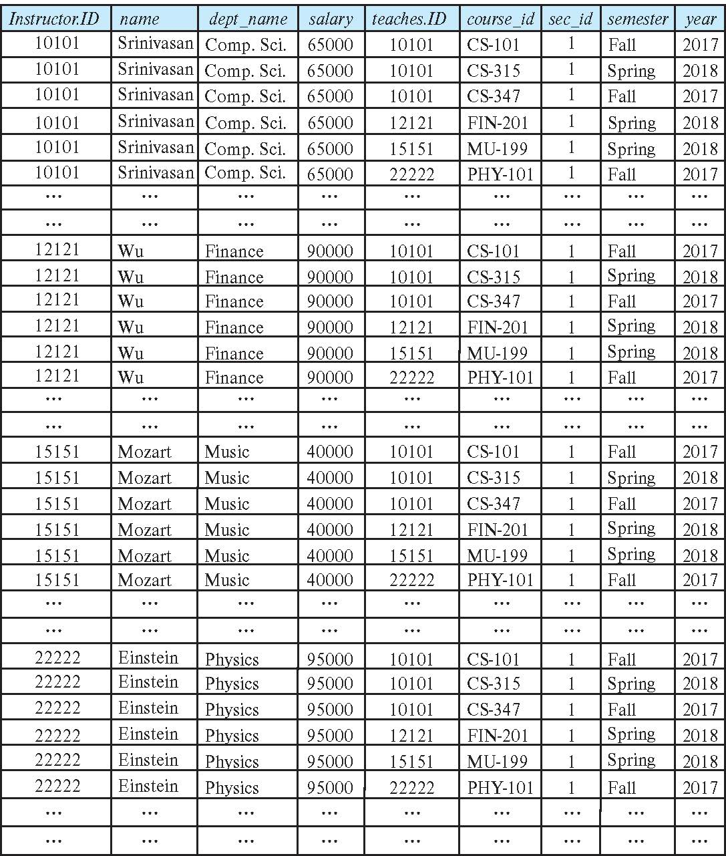
The instructor X teaches table

Slide 16
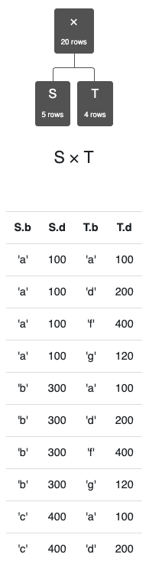
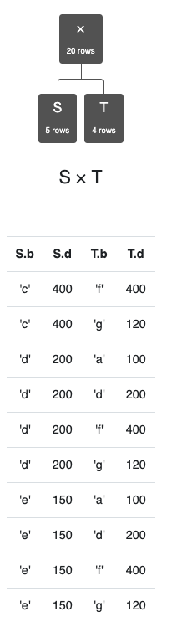
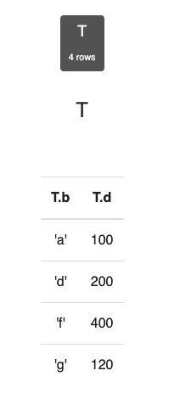
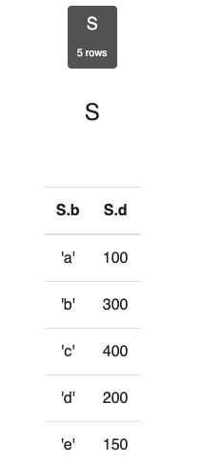
Simpler Example
Assume we have two tables
S has two columns, 5 rows.
T has two columns, 4 rows.
S x T has
4 columns.
20 rows.
Cartesian product does not come up a lot in applications.
There are cases in optimization in which:
You want to generate all possible combinations.
Score, rate, rank etc. to determine best choices.

Slide 17
Join Operation
The Cartesian-Product
instructor X teaches
associates every tuple of instructor with every tuple of teaches.
Most of the resulting rows have information about instructors who did NOT teach a particular course.
To get only those tuples of “instructor X teaches “ that pertain to instructors and the courses that they taught, we write:
σ _{instructor.id = teaches.id} (instructor x teaches ))
We get only those tuples of “instructor X teaches” that pertain to instructors and the courses that they taught.
The result of this expression, shown in the next slide
A fundamental definition:
σ _{instructor.ID=teaches.ID} (instructor ⨯ teaches) = instructor ⨝ teaches
⨝ is the JOIN operations.

Slide 18
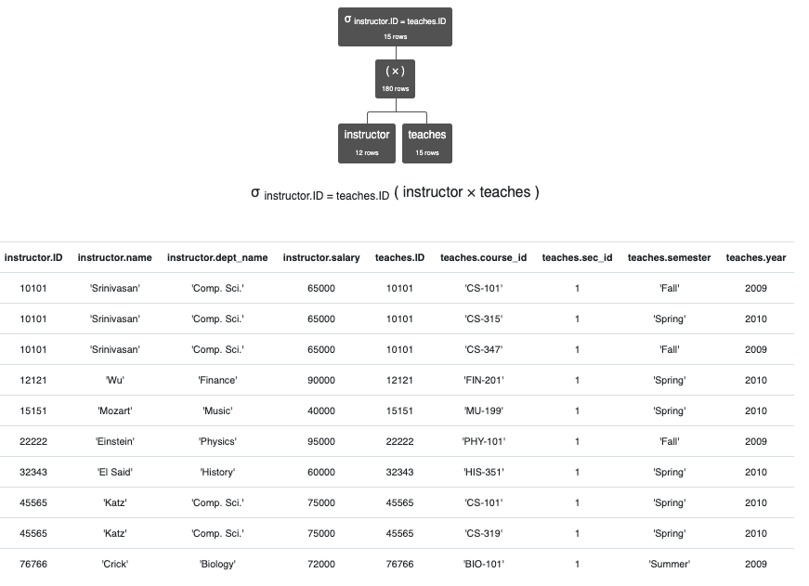
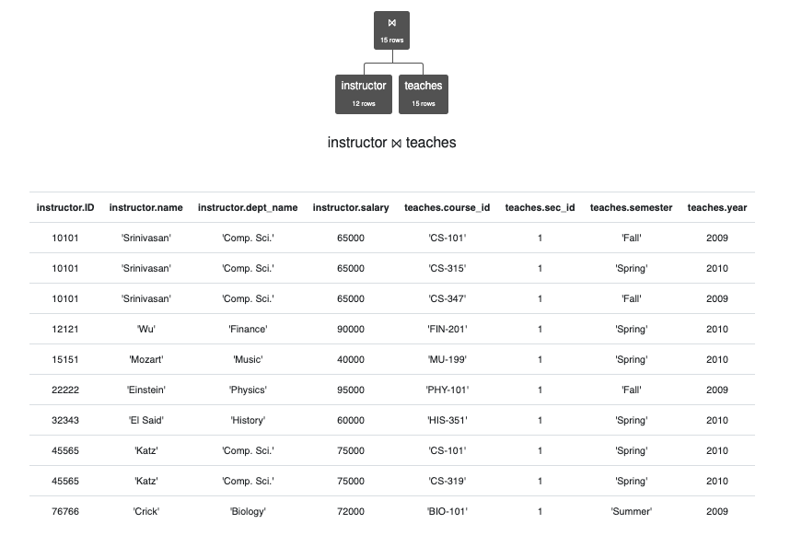
JOIN Definition
σ _{instructor.ID=teaches.ID} (instructor ⨯ teaches)
instructor ⨝ teaches
instructor ⨝ _{instructor.ID>teaches.ID} teaches

Slide 19
Types of JOIN
Tables
T = (a,b,c)
S = (a,b,d)
Natural Join
T.a=S.a
T.b=S.b
Equi-Join
T.a=S.a
Theta-Join
T.a>S.a

Slide 20
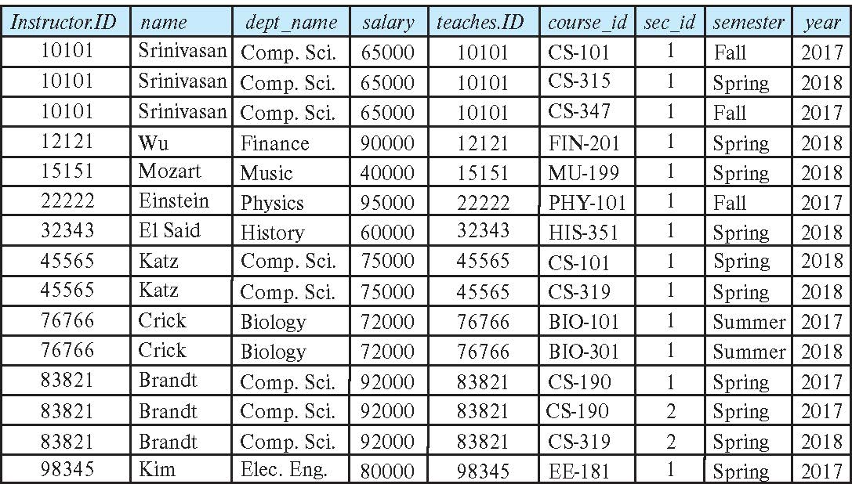
Join Operation (Cont.)
The table corresponding to:
σ _{instructor.id = teaches.id} (instructor x teaches))

Slide 21
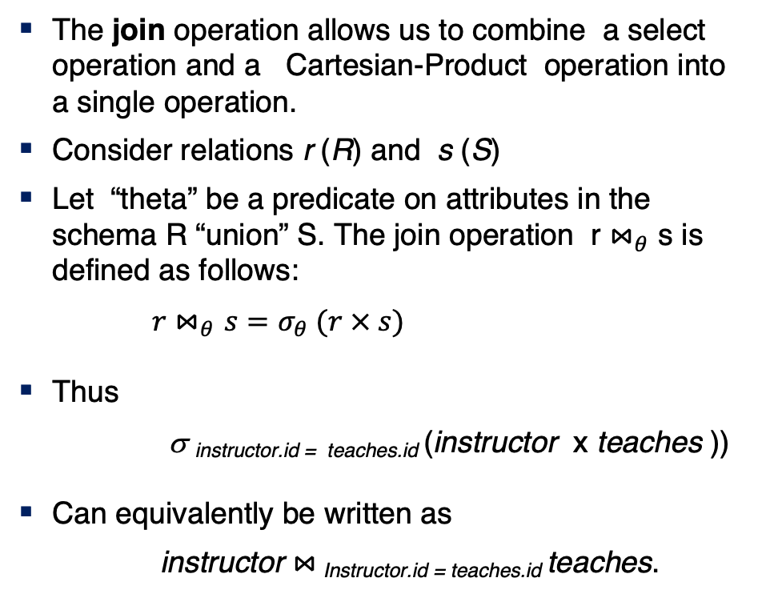
Join Operation (Cont.)
The join operation allows us to combine a select operation and a Cartesian-Product operation into a single operation.
Consider relations r (R) and s (S)
Let “theta” be a predicate on attributes in the schema R “union” S. The join operation r $⋈_{θ}$ s is defined as follows:
$r⋈_{θ}s=σ_{θ} (r × s)$
Thus
σ _{instructor.id = teaches.id} (instructor x teaches ))
Can equivalently be written as
instructor $⋈_{ }$_{Instructor.id = teaches.id} teaches.

Slide 22
Union Operation
The union operation allows us to combine two relations
Notation: r ∪ s
For r ∪ s to be valid.
1. r, s must have the same arity (same number of attributes)
2. The attribute domains must be compatible (example: 2nd
column of r deals with the same type of values as does the 2nd column of s)
Example: to find all courses taught in the Fall 2017 semester, or in the Spring 2018 semester, or in both ∏_{course_id} (σ _{semester=“Fall” Λ year=2017} (section)) ∪ ∏_{course_id} (σ _{semester=“Spring” Λ year=2018} (section))
(a,b,c,d)
(x,y)
Project(a,

Slide 23
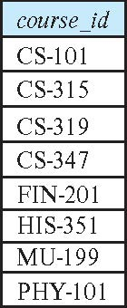
Union Operation (Cont.)
Result of: ∏_{course_id} (σ _{semester=“Fall” Λ year=2017} (section)) ∪ ∏_{course_id} (σ _{semester=“Spring” Λ year=2018} (section))
Note: The preloaded dataset on the RelaX calculator is different from the most recent data referenced in the book. It is from a previous edition.

Slide 24
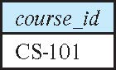
Set-Intersection Operation
The set-intersection operation allows us to find tuples that are in both the input relations.
Notation: r ∩ s
Assume:
r, s have the same arity
attributes of r and s are compatible
Example: Find the set of all courses taught in both the Fall 2017 and the Spring 2018 semesters.
∏_{course_id} (σ _{semester=“Fall” Λ year=2017} (section)) ∩ ∏_{course_id} (σ _{semester=“Spring” Λ year=2018} (section))
Result

Slide 25
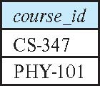
Set Difference Operation
The set-difference operation allows us to find tuples that are in one relation but are not in another.
Notation r – s
Set differences must be taken between compatible relations.
r and s must have the same arity
attribute domains of r and s must be compatible
Example: to find all courses taught in the Fall 2017 semester, but not in the Spring 2018 semester ∏_{course_id} (σ _{semester=“Fall” Λ year=2017} (section)) − ∏_{course_id} (σ _{semester=“Spring” Λ year=2018} (section))

Slide 26
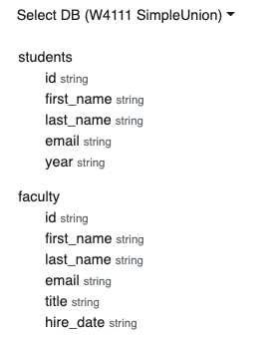
Same “arity”
Same “arity”
Same number of columns.
Compatible types.
The i-th column in each table is from a compatible domain.
Student 5th column is “year.”
Faculty 5th column is “title”
Both are strings but combing them does not make sense.
You can shape two incompatible tables using project operations. For example
π first_name,last_name,email (students) ∩ π first_name,last_name,email (faculty)
π last_name,email, title←'Student' (students) ∪ π last_name,email, title (faculty)

Slide 27
The Assignment Operation
It is convenient at times to write a relational-algebra expression by assigning parts of it to temporary relation variables.
The assignment operation is denoted by ← and works like assignment in a programming language.
Example: Find all instructor in the “Physics” and Music department. Physics ← σ _{dept_name=“Physics”} (instructor)
Music ← σ _{dept_name=“Music”} (instructor)
Physics ∪ Music
With the assignment operation, a query can be written as a sequential program consisting of a series of assignments followed by an expression whose value is displayed as the result of the query.

Slide 28
The Rename Operation
The results of relational-algebra expressions do not have a name that we can use to refer to them. The rename operator, ρ , is provided for that purpose
The expression:
ρ_{x} (E)
returns the result of expression E under the name x
Another form of the rename operation:
ρ_{x(A1,A2, .. An)} (E)
Note: Assignment and rename can act a little wonky when using the calculator.

Slide 29
Equivalent Queries
There is more than one way to write a query in relational algebra.
Example: Find information about courses taught by instructors in the Physics department with salary greater than 90,000
Query 1
σ _{dept_name=“Physics”} ∧ _{salary > 90,000} (instructor)
Query 2
σ _{dept_name=“Physics”} (σ _{salary > 90.000} (instructor))
The two queries are not identical; they are, however, equivalent -- they give the same result on any database.

Slide 30
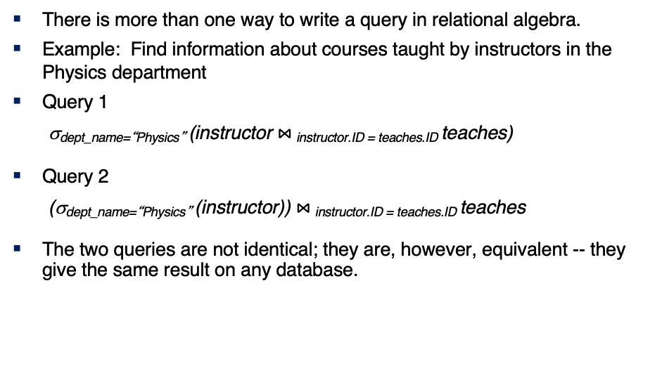
Equivalent Queries
There is more than one way to write a query in relational algebra.
Example: Find information about courses taught by instructors in the Physics department
Query 1
σ_{dept_name=“Physics”} (instructor $⋈_{ }$_{instructor.ID = teaches.ID} teaches)
Query 2
(σ_{dept_name=“Physics”} (instructor)) $⋈_{ }$_{instructor.ID = teaches.ID} teaches
The two queries are not identical; they are, however, equivalent -- they give the same result on any database.

Slide 31
What are all those other Symbols?
Some of these are pretty obscure
Division
Anti-Join
Left semi-join
Right semi-join
Most SQL engines do not support them.
You can implement them using combinations of JOIN, SELECT, WHERE, ... ...
But, I cannot every remember using them in applications I have developed.
Outer JOIN is very useful, but less common. We will cover.
There are also some “patterns” or “terms”
Equijoin
Non-equi join
Natural join
Theta join
... ...
I may ask you to define these terms on some exams because they may be common internships/job interview questions.
τ order by
γ group by
¬ negation
÷ set division
⨝ natural join, theta-join
⟕ left outer join
⟖ right outer join
⟗ full outer join
⋉ left semi join
⋊ right semi join
▷ anti-join

Slide 32
SQL (II)
32 | COMS W4111_002_2021_1: Lecture 2: ER, Relational, SQL (II) © Donald F. Ferguson, 2021

Slide 33
Outline
Overview of The SQL Query Language
SQL Data Definition
Basic Query Structure of SQL Queries
Additional Basic Operations
Set Operations
Null Values
Aggregate Functions
Nested Subqueries
Modification of the Database
Covered Last Lecture
Notes:
1

Slide 34
Additional Operations
We have to discuss types/domains before talking about some of the other material.

Slide 35
Data Types and Functions
35 | COMS W4111_002_2021_1: Lecture 3: ER, Relational, SQL (III) © Donald F. Ferguson, 2021

Slide 36
Domain Types in SQL
char(n). Fixed length character string, with user-specified length n.
varchar(n). Variable length character strings, with user-specified maximum length n.
int. Integer (a finite subset of the integers that is machine-dependent).
smallint. Small integer (a machine-dependent subset of the integer domain type).
numeric(p,d). Fixed point number, with user-specified precision of p digits, with d digits to the right of decimal point. (ex., numeric(3,1), allows 44.5 to be stores exactly, but not 444.5 or 0.32)
real, double precision. Floating point and double-precision floating point numbers, with machine-dependent precision.
float(n). Floating point number, with user-specified precision of at least n digits.
More are covered in Chapter 4.

Slide 37
Built-in Data Types in SQL
date: Dates, containing a (4 digit) year, month and date
Example: date '2005-7-27'
time: Time of day, in hours, minutes and seconds.
Example: time '09:00:30' time '09:00:30.75'
timestamp: date plus time of day
Example: timestamp '2005-7-27 09:00:30.75'
interval: period of time
Example: interval '1' day
Subtracting a date/time/timestamp value from another gives an interval value
Interval values can be added to date/time/timestamp values
Note:
All implementations of SQL support a common core, but ...
The have proprietary extensions: operators on types, additional types.

Slide 38
Large-Object Types
Large objects (photos, videos, CAD files, etc.) are stored as a large object:
blob: binary large object -- object is a large collection of uninterpreted binary data (whose interpretation is left to an application outside of the database system)
clob: character large object -- object is a large collection of character data
When a query returns a large object, a pointer is returned rather than the large object itself.
Note:
CLOBs and BLOBs are very uncommon.
Today applications keep documents, images, CAD files, etc. in “block/object storage.”
The database contains just the hyperlinks to the files/content.
We will see some examples when we talk about web applications.

Slide 39
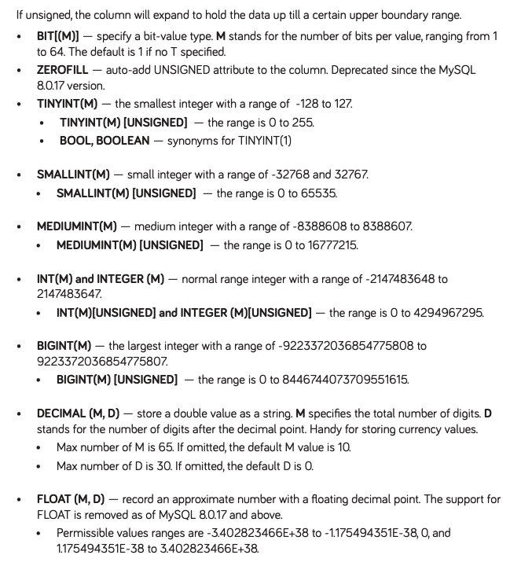
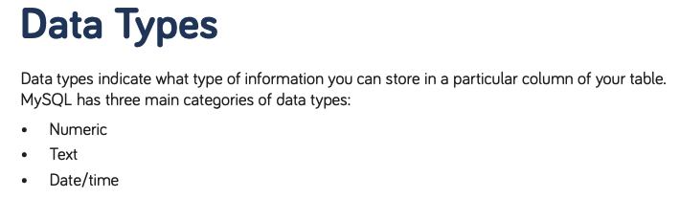
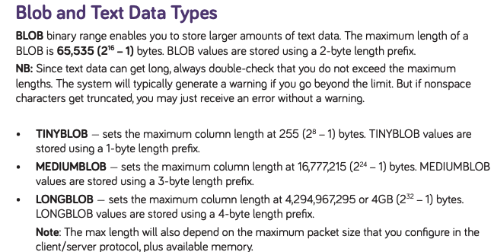
MySQL Cheat Sheet
https://websitesetup.org/wp-content/uploads/2020/04/MySQL-Cheat-Sheet-websitesetup.org.pdf Pretty good, concise place to find information about MySQL.
https://dev.mysql.com/doc/refman/8.0/en/data-types.html
These lists are not complete.

Slide 40
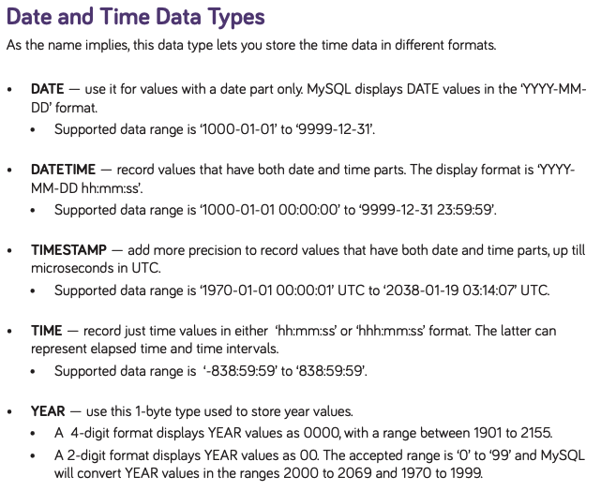
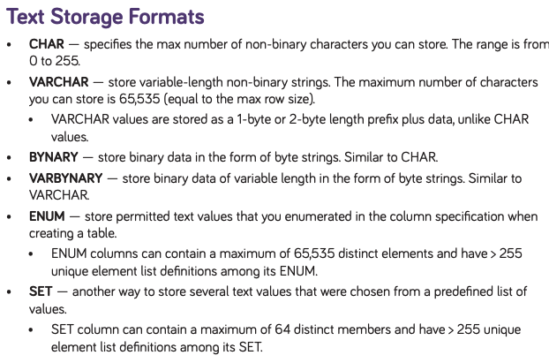
MySQL Cheat Sheet
https://websitesetup.org/wp-content/uploads/2020/04/MySQL-Cheat-Sheet-websitesetup.org.pdf Pretty good, concise place to find information about MySQL.
https://dev.mysql.com/doc/refman/8.0/en/data-types.html
These lists are not complete for the basic groups, and there are some advanced types (JSON, Spatial).
You learn all of this by practicing, trial and error, etc.

Slide 41
String Operations
SQL includes a string-matching operator for comparisons on character strings. The operator like uses patterns that are described using two special characters:
percent ( % ). The % character matches any substring.
underscore ( _ ). The _ character matches any character.
Find the names of all instructors whose name includes the substring “dar”.
select name from instructor where name like '%dar%'
Match the string “100%”
like '100 \%' escape '\'
in that above we use backslash (\) as the escape character.

Slide 42
String Operations (Cont.)
Patterns are case sensitive.
Pattern matching examples:
'Intro%' matches any string beginning with “Intro”.
'%Comp%' matches any string containing “Comp” as a substring.
'_ _ _' matches any string of exactly three characters.
'_ _ _ %' matches any string of at least three characters.
SQL supports a variety of string operations such as
concatenation (using “||”)
converting from upper to lower case (and vice versa)
finding string length, extracting substrings, etc.

Slide 43
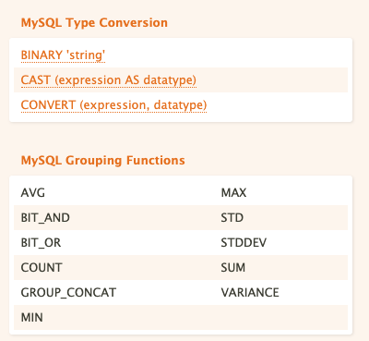
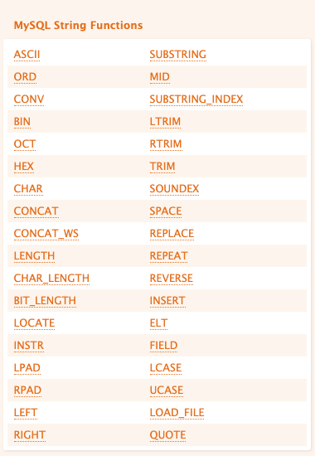
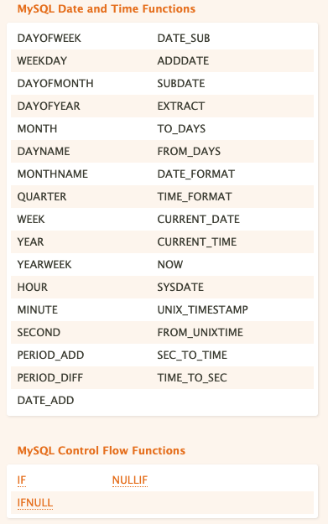
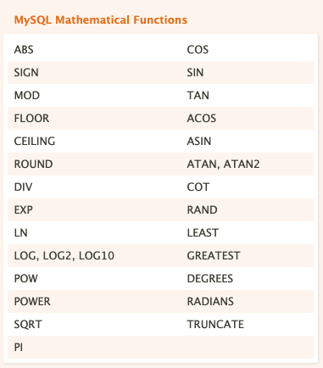
Operations and Functions
Almost all programming languages have similar function libraries.

Slide 44
Operations and Functions
How do you learn all of these functions?
Well, “How do I get to Carnegie Hall?”
“Practice.”
Switch to notebook.

Slide 45
Summary
SQL Data Types:
There is a common, standard core set of data types that all SQL implementations support.
Most SQL implementations have additional types and extensions.
Functions on Data Types:
There is a common, standard core set of functions for each data type that all SQL implementations support.
Most SQL implementations have additional functions and extensions.
I do not expect you to memorize the types, functions, etc. You can look them up, play with them, ... On homework assignments and exams.
We saw some interesting additional features that we will cover later in this lecture:
GROUP BY
ORDER BY

Slide 46
Order By
46 | COMS W4111_002_2021_1: Lecture 3: ER, Relational, SQL (III) © Donald F. Ferguson, 2021

Slide 47
Ordering the Display of Tuples
List in alphabetic order the names of all instructors
select distinct name from instructor order by name
We may specify desc for descending order or asc for ascending order, for each attribute; ascending order is the default.
Example: order by name desc
Can sort on multiple attributes
Example: order by dept_name, name
Show notebook for order by example.

Slide 48
INSERT, UPDATE, DELETE
48 | COMS W4111_002_2021_1: Lecture 3: ER, Relational, SQL (III) © Donald F. Ferguson, 2021

Slide 49
Updates to tables
Insert
insert into instructor values ('10211', 'Smith', 'Biology', 66000);
Delete
Remove all tuples from the student relation
delete from student
Drop Table
drop table r
Alter
alter table r add A D
where A is the name of the attribute to be added to relation r and D is the domain of A.
All exiting tuples in the relation are assigned null as the value for the new attribute.
alter table r drop A
where A is the name of an attribute of relation r
Dropping of attributes not supported by many databases.

Slide 50
Modification of the Database
Deletion of tuples from a given relation.
Insertion of new tuples into a given relation
Updating of values in some tuples in a given relation

Slide 51
Deletion
Delete all instructors
delete from instructor
Delete all instructors from the Finance department delete from instructor where dept_name= 'Finance’;
Delete all tuples in the instructor relation for those instructors associated with a department located in the Watson building.
delete from instructor where dept name in (select dept name from department where building = 'Watson');

Slide 52
Deletion (Cont.)
Delete all instructors whose salary is less than the average salary of instructors
Problem: as we delete tuples from instructor, the average salary changes
Solution used in SQL:
First, compute avg (salary) and find all tuples to delete
Next, delete all tuples found above (without recomputing avg or retesting the tuples)
delete from instructor
where salary < (select avg (salary)
from instructor);

Slide 53
Insertion
Add a new tuple to course
insert into course values ('CS-437', 'Database Systems', 'Comp. Sci.', 4);
or equivalently
insert into course (course_id, title, dept_name, credits) values ('CS-437', 'Database Systems', 'Comp. Sci.', 4);
Add a new tuple to student with tot_creds set to null
insert into student values ('3003', 'Green', 'Finance', null);

Slide 54
Insertion (Cont.)
Make each student in the Music department who has earned more than 144 credit hours an instructor in the Music department with a salary of $18,000.
insert into instructor select ID, name, dept_name, 18000 from student where dept_name = 'Music' and total_cred > 144;
The select from where statement is evaluated fully before any of its results are inserted into the relation.
Otherwise queries like
insert into table1 select * from table1
would cause problem

Slide 55
Updates
Give a 5% salary raise to all instructors
update instructor set salary = salary * 1.05
Give a 5% salary raise to those instructors who earn less than 70000 update instructor set salary = salary * 1.05 where salary < 70000;
Give a 5% salary raise to instructors whose salary is less than average
update instructor set salary = salary * 1.05 where salary < (select avg (salary) from instructor);

Slide 56
Updates (Cont.)
Increase salaries of instructors whose salary is over $100,000 by 3%, and all others by a 5%
Write two update statements:
update instructor set salary = salary * 1.03 where salary > 100000; update instructor set salary = salary * 1.05 where salary <= 100000;
The order is important
Can be done better using the case statement (next slide)

Slide 57
Case Statement for Conditional Updates
Same query as before but with case statement
update instructor set salary = case when salary <= 100000 then salary * 1.05 else salary * 1.03 end

Slide 58
Updates with Scalar Subqueries
Recompute and update tot_creds value for all students
update student S set tot_cred = (select sum(credits) from takes, course where takes.course_id = course.course_id and S.ID= takes.ID.and takes.grade <> 'F' and takes.grade is not null);
Sets tot_creds to null for students who have not taken any course
Instead of sum(credits), use:
case when sum(credits) is not null then sum(credits) else 0 end

Slide 59
Summary
INSERT, UPDATE and DELETE are pretty straightforward.
UPDATE and DELETE are very similar to SELECT
WHERE clause specifies which rows are affected.
The SELECT choose the columns to return.
The SET clause chooses and changes columns.
DELETE just removes the specified rows.
INSERT, UPDATE and DELETE changes must not violate constraints, e.g.
INSERT a row that causes a duplicate key.
DELETE a referenced (target) foreign key.
UPDATE columns that create a duplicate key.
INSERT values do not include all NOT NULL columns.
I am not going to do example now, but you have seen and will see me do examples in the context of larger examples.

Slide 60
Aggregate Functions
60 | COMS W4111_002_2021_1: Lecture 3: ER, Relational, SQL (III) © Donald F. Ferguson, 2021

Slide 61
Aggregate Functions
These functions operate on the multiset of values of a column of a relation, and return a value
avg: average value min: minimum value max: maximum value sum: sum of values count: number of values
Note: Some database implementations have additional aggregate functions.

Slide 62
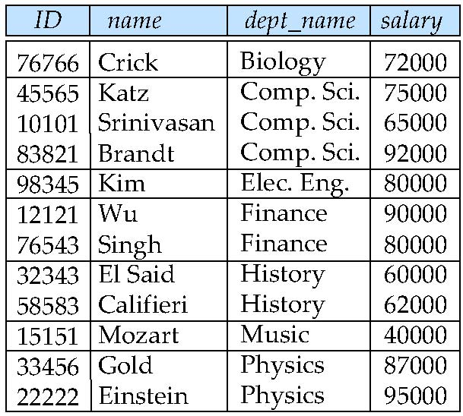
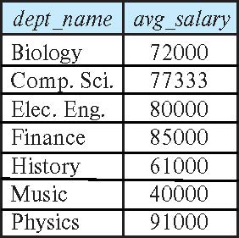
Aggregate Functions – Group By
Find the average salary of instructors in each department
select dept_name, avg (salary) as avg_salary from instructor group by dept_name;

Slide 63
Another View
GROUP BY column list
Forms partitions containing multiple rows.
All rows in a partition have the same values for the GROUP BY columns.
The aggregate functions
Merge the non-group by attributes, which may differ from row to row.
Into a single value for each attribute.
The result is one row per distinct set of GROUP BY values.
There may be multiple non-GROUP BY COLUMNS, each with its own aggregate function.
You can use HAVING in place of WHERE on the GROUP BY result.

Slide 64
Aggregate Functions Examples
Find the average salary of instructors in the Computer Science department
select avg (salary) from instructor where dept_name= 'Comp. Sci.';
Find the total number of instructors who teach a course in the Spring 2018 semester
select count (distinct ID) from teaches where semester = 'Spring' and year = 2018;
Find the number of tuples in the course relation
select count (*) from course;

Slide 65
Aggregation (Cont.)
Attributes in select clause outside of aggregate functions must appear in group by list
/* erroneous query */ select dept_name, ID, avg (salary) from instructor group by dept_name;

Slide 66
Aggregate Functions – Having Clause
Find the names and average salaries of all departments whose average salary is greater than 42000
Note: predicates in the having clause are applied after the formation of groups whereas predicates in the where clause are applied before forming groups
select dept_name, avg (salary) as avg_salary
from instructor
group by dept_name
having avg (salary) > 42000;

Slide 67
Example
Switch to notebook.
Career batting statistics.

Slide 68
JOIN
68 | COMS W4111_002_2021_1: Lecture 3: ER, Relational, SQL (III) © Donald F. Ferguson, 2021

Slide 69
Joined Relations
Join operations take two relations and return as a result another relation.
A join operation is a Cartesian product which requires that tuples in the two relations match (under some condition). It also specifies the attributes that are present in the result of the join
The join operations are typically used as subquery expressions in the from clause
Three types of joins:
Natural join
Inner join
Outer join
Notes:
You will also hear terms like equi-join, non-equi-join, theta join, semi-join, ... ...
I ask for definitions on exams, but you can just look them up.

Slide 70
Natural Join in SQL
Natural join matches tuples with the same values for all common attributes, and retains only one copy of each common column.
List the names of instructors along with the course ID of the courses that they taught
select name, course_id from students, takes where student.ID = takes.ID;
Same query in SQL with “natural join” construct
select name, course_id from student natural join takes;

Slide 71
Natural Join in SQL (Cont.)
The from clause can have multiple relations combined using natural join:
select A₁, A₂, … A_{n} from r₁ natural join r₂ natural join .. natural join r_{n} where P ;

Slide 72
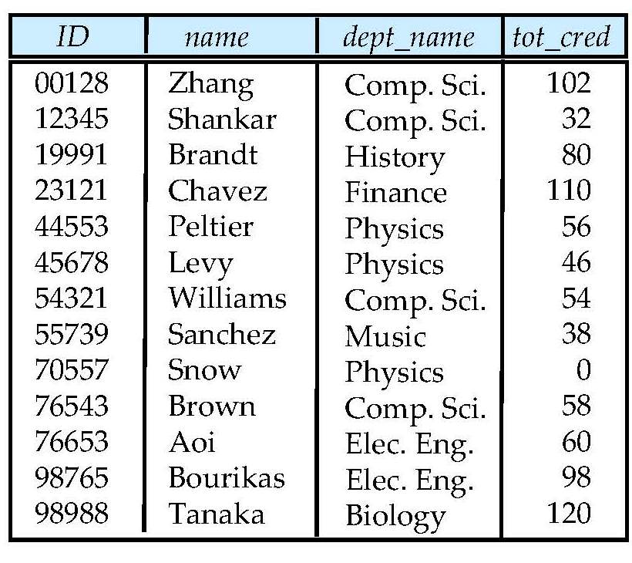
Student Relation

Slide 73
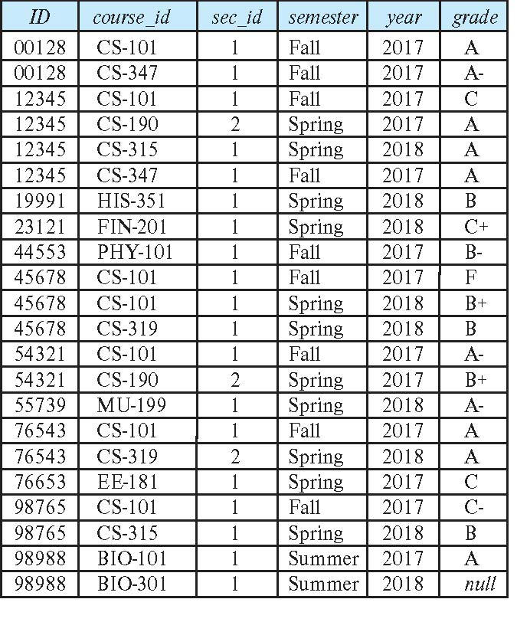
Takes Relation

Slide 74
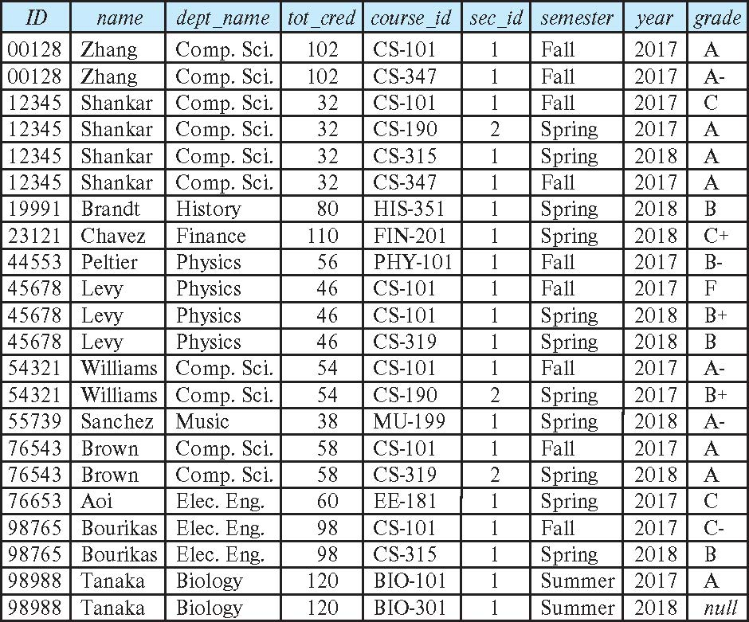
student natural join takes

Slide 75
Dangerous in Natural Join
Beware of unrelated attributes with same name which get equated incorrectly
Example -- List the names of students instructors along with the titles of courses that they have taken
Correct version
select name, title from student natural join takes, course where takes.course_id = course.course_id;
Incorrect version
select name, title from student natural join takes natural join course;
This query omits all (student name, course title) pairs where the student takes a course in a department other than the student's own department.
The correct version (above), correctly outputs such pairs.

Slide 76
Natural Join with Using Clause
To avoid the danger of equating attributes erroneously, we can use the “using” construct that allows us to specify exactly which columns should be equated.
Query example
select name, title from (student natural join takes) join course using (course_id)

Slide 77
Join Condition
The on condition allows a general predicate over the relations being joined
This predicate is written like a where clause predicate except for the use of the keyword on
Query example
select * from student join takes on student_ID = takes_ID
The on condition above specifies that a tuple from student matches a tuple from takes if their ID values are equal.
Equivalent to:
select * from student , takes where student_ID = takes_ID

Slide 78
Join Condition (Cont.)
The on condition allows a general predicate over the relations being joined.
This predicate is written like a where clause predicate except for the use of the keyword on.
Query example
select * from student join takes on student_ID = takes_ID
The on condition above specifies that a tuple from student matches a tuple from takes if their ID values are equal.
Equivalent to:
select * from student , takes where student_ID = takes_ID

Slide 79
One Way to Think About Joins

Slide 80
Set Operations
80 | COMS W4111_002_2021_1: Lecture 3: ER, Relational, SQL (III) © Donald F. Ferguson, 2021

Slide 81
Set Operations

Slide 82
Set Operations (Cont.)
Set operations union, intersect, and except
Each of the above operations automatically eliminates duplicates
To retain all duplicates use the
union all,
intersect all
except all.
NOTE:
SELECT implementing a project can have duplicate rows. If you do not want duplicates, you must use the DISTINCT key word.
UNION behaves the other way. It removes duplicates. If you want to keep the duplicates, you have to select UNION ALL.
Some SQL engines do not implement INTERSECT and/or EXCEPT, you can implement the function with subqueries, which we will cover soon.

Slide 83
Set Operations
Find courses that ran in Fall 2017 or in Spring 2018
(select course_id from section where sem = 'Fall' and year = 2017) union (select course_id from section where sem = 'Spring' and year = 2018)
Find courses that ran in Fall 2017 and in Spring 2018
(select course_id from section where sem = 'Fall' and year = 2017) intersect (select course_id from section where sem = 'Spring' and year = 2018)
Find courses that ran in Fall 2017 but not in Spring 2018
(select course_id from section where sem = 'Fall' and year = 2017) except (select course_id from section where sem = 'Spring' and year = 2018)

Slide 84
Let’s Practice – Go to the Notebook

Slide 85
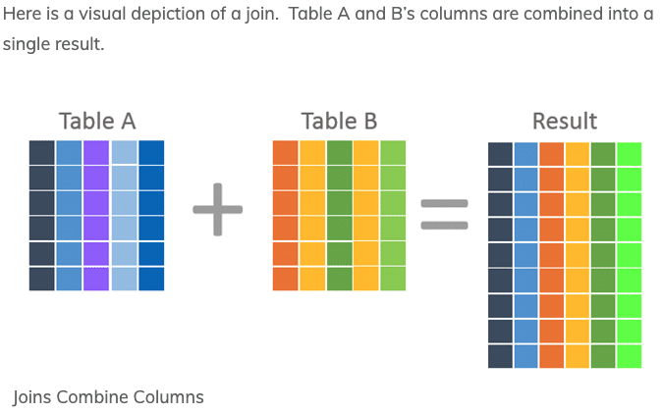
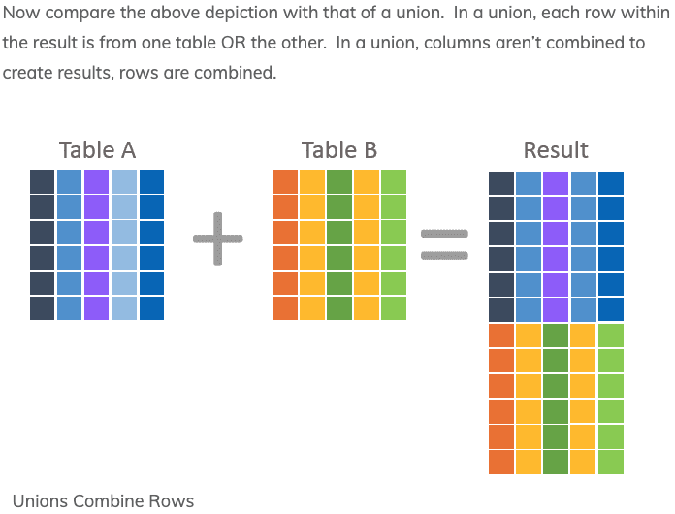
JOIN and UNION – A Final Word
UNION vs JOIN can be confusing. Basically,
JOIN puts the tables together “side by side.”
Union puts the tables together “one on top of the oter.”

Slide 86
Let’s Practice You Guessed It. Over to the Notebook. It is Baseball and Game of Thrones Time!
86 | COMS W4111_002_2021_1: Lecture 3: ER, Relational, SQL (III) © Donald F. Ferguson, 2021

Slide 87
Sub-Query
87 | COMS W4111_002_2021_1: Lecture 3: ER, Relational, SQL (III) © Donald F. Ferguson, 2021

Slide 88
Nested Subqueries
SQL provides a mechanism for the nesting of subqueries. A subquery is a select-from-where expression that is nested within another query.
The nesting can be done in the following SQL query select A₁, A₂, ..., A_{n} from r₁, r₂, ..., r_{m} where P
as follows:
From clause: r_{i} can be replaced by any valid subquery
Where clause: P can be replaced with an expression of the form:
B <operation> (subquery)
B is an attribute and <operation> to be defined later.
Select clause:
A_{i} can be replaced be a subquery that generates a single value.
Note:
This is a little cryptic.
I think I know what they mean.
There are some operations we will see later in the material, e.g IN, EXISTS, ... ...

Slide 89
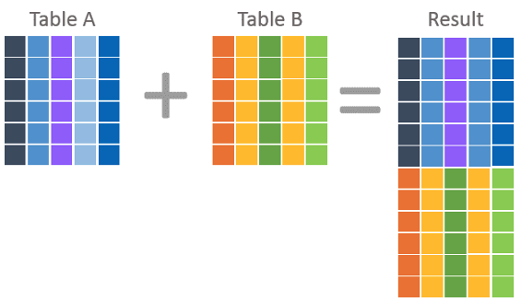
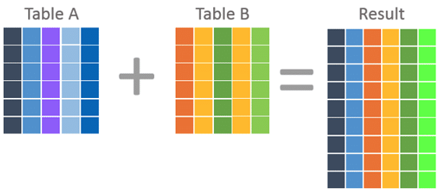
Nested Subquery
The slides that come with the book have surprisingly little material on nested subqueries.
The concept is:
Extremely important.
Students often find subqueries more confusing than joins.
The relationship/difference of subqueries to joins is often, initial unclear.
We have seen:
Union sort of puts a table on top of a table.
Join puts tables sort of puts tables side-by-side.
Subquery enables one query to call another during execution like a subfunction.

Slide 90
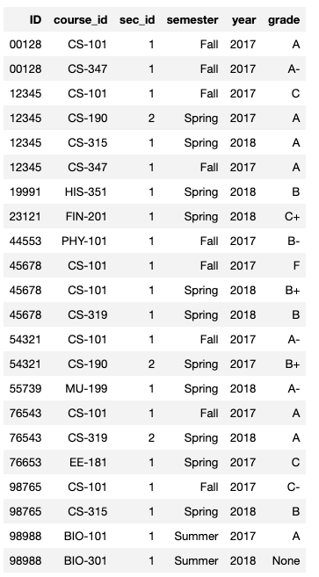
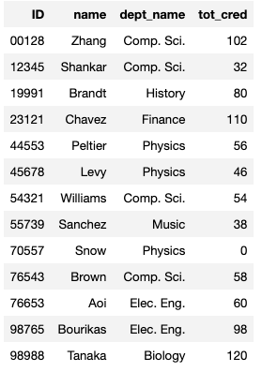
Consider Some Tables
Student
Takes

Slide 91
Consider a Subquery Tables
select *, (select name from student where student.id=takes.id) as name from takes;
Assume I wrote a function find_student_name(x)
Input is an x
Loops through all students and returns students with studentID = X.
The query with a subquery above is like:
result = []
For t in takes:
new_r = t + find_student_name(t.id)
result.append(new_r)
Switch to Notebook
Takes
Student

Slide 92
Nested Subqueries
SQL provides a mechanism for the nesting of subqueries. A subquery is a select-from-where expression that is nested within another query.
The nesting can be done in the following SQL query select A₁, A₂, ..., A_{n} from r₁, r₂, ..., r_{m} where P
as follows:
From clause: r_{i} can be replaced by any valid subquery
Where clause: P can be replaced with an expression of the form:
B <operation> (subquery)
B is an attribute and <operation> to be defined later.
Select clause:
A_{i} can be replaced be a subquery that generates a single value.
Note: Subquery MUST return
A single scalar if in the SELECT.
A Table if in the FROM.
If in the WHERE:
Either a scalar or a table.
Depending on the operation.

Slide 93
Set Membership

Slide 94
Set Membership
Find courses offered in Fall 2017 and in Spring 2018
Find courses offered in Fall 2017 but not in Spring 2018
select distinct course_id
from section
where semester = 'Fall' and year= 2017 and course_id in (select course_id
from section
where semester = 'Spring' and year= 2018);
select distinct course_id
from section
where semester = 'Fall' and year= 2017 and course_id not in (select course_id
from section
where semester = 'Spring' and year= 2018);

Slide 95
Set Membership (Cont.)
Name all instructors whose name is neither “Mozart” nor Einstein”
select distinct name
from instructor
where name not in ('Mozart', 'Einstein')
Find the total number of (distinct) students who have taken course sections taught by the instructor with ID 10101
Note: Above query can be written in a much simpler manner. The formulation above is simply to illustrate SQL features
select count (distinct ID)
from takes
where (course_id, sec_id, semester, year) in (select course_id, sec_id, semester, year
from teaches
where teaches.ID= 10101);

Slide 96
Set Comparison

Slide 97
Set Comparison – “some” Clause
Find names of instructors with salary greater than that of some (at least one) instructor in the Biology department.
Same query using > some clause
select distinct T.name
from instructor as T, instructor as S
where T.salary > S.salary and S.dept name = 'Biology';
select name
from instructor
where salary > some (select salary
from instructor
where dept name = 'Biology');

Slide 98
Definition of “some” Clause
F <comp> some r ⇔ ∃ t ∈ r such that (F <comp> t ) Where <comp> can be: <, ≤, >, =, ≠
0
(5 < some
5
) = true
(read: 5 < some tuple in the relation)
6
0
(5 < some
5
) = false
0
(5 = some
) = true
5
0
(5 ≠ some
5
) = true (since 0 ≠ 5)
(= some) ≡ in
However, (≠ some) ≡ not in

Slide 99
Set Comparison – “all” Clause
Find the names of all instructors whose salary is greater than the salary of all instructors in the Biology department.
select name
from instructor
where salary > all (select salary
from instructor
where dept name = 'Biology');

Slide 100
Definition of “all” Clause
F <comp> all r ⇔ ∀ t ∈ r (F <comp> t)
0
(5 < all
5
) = false
6
6
(5 < all
) = true
10
4
(5 = all
) = false
5
4
(5 ≠ all
) = true (since 5 ≠ 4 and 5 ≠ 6)
6
(≠ all) ≡ not in
However, (= all) ≡ in

Slide 101
Test for Empty Relations
The exists construct returns the value true if the argument subquery is nonempty.
exists r ⇔ r ≠ Ø
not exists r ⇔ r = Ø

Slide 102
Use of “exists” Clause
Yet another way of specifying the query “Find all courses taught in both the Fall 2017 semester and in the Spring 2018 semester”
select course_id from section as S where semester = 'Fall' and year = 2017 and exists (select * from section as T where semester = 'Spring' and year= 2018 and S.course_id = T.course_id);
Correlation name – variable S in the outer query
Correlated subquery – the inner query

Slide 103
Use of “not exists” Clause
Find all students who have taken all courses offered in the Biology department.
Note that X – Y = Ø ⇔ X ⊆ Y
Note: Cannot write this query using = all and its variants
select distinct S.ID, S.name
from student as S
where not exists ( (select course_id
from course
where dept_name = 'Biology')
except
(select T.course_id
from takes as T
where S.ID = T.ID));
First nested query lists all courses offered in Biology
Second nested query lists all courses a particular student took

Slide 104
Test for Absence of Duplicate Tuples
The unique construct tests whether a subquery has any duplicate tuples in its result.
The unique construct evaluates to “true” if a given subquery contains no duplicates .
Find all courses that were offered at most once in 2017
select T.course_id from course as T where unique ( select R.course_id from section as R where T.course_id= R.course_id and R.year = 2017);

Slide 105
Subqueries in the From Clause

Slide 106
Subqueries in the Form Clause
SQL allows a subquery expression to be used in the from clause
Find the average instructors’ salaries of those departments where the average salary is greater than $42,000.”
select dept_name, avg_salary from ( select dept_name, avg (salary) as avg_salary from instructor group by dept_name) where avg_salary > 42000;
Note that we do not need to use the having clause
Another way to write above query
select dept_name, avg_salary from ( select dept_name, avg (salary) from instructor group by dept_name)
as dept_avg (dept_name, avg_salary)
where avg_salary > 42000;

Slide 107
With Clause
The with clause provides a way of defining a temporary relation whose definition is available only to the query in which the with clause occurs.
Find all departments with the maximum budget with max_budget (value) as (select max(budget) from department) select department.name from department, max_budget where department.budget = max_budget.value;

Slide 108
Complex Queries using With Clause
Find all departments where the total salary is greater than the average of the total salary at all departments
with dept _total (dept_name, value) as
(select dept_name, sum(salary)
from instructor
group by dept_name),
dept_total_avg(value) as
(select avg(value)
from dept_total)
select dept_name
from dept_total, dept_total_avg
where dept_total.value > dept_total_avg.value;

Slide 109
Scalar Subquery
Scalar subquery is one which is used where a single value is expected
List all departments along with the number of instructors in each department
select dept_name, ( select count(*) from instructor where department.dept_name = instructor.dept_name) as num_instructors from department;
Runtime error if subquery returns more than one result tuple

Slide 110
Backup
Backup

Slide 111
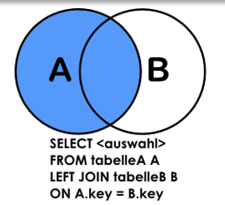
Left JOIN
The easiest way to think about this is ...
Do a “normal” JOIN that produces all of the pairs of matching rows.
There MAY be some some rows in A that did not match anything.
For each of those rows,
Put one row in the JOIN result
That has the column values from A and NULL values for the columns from B.
Right JOIN is exactly the same, except swap the logic for A and B.
A FULL OUTER JOIN is the UNION of a left join and a right join. Some SQL engines do not support it and you must explicitly do the left, right and union.

Slide 112
Today’s Task #1
112 | COMS W4111_002_2021_1: Lecture 2: ER, Relational, SQL (II) © Donald F. Ferguson, 2021

Slide 113
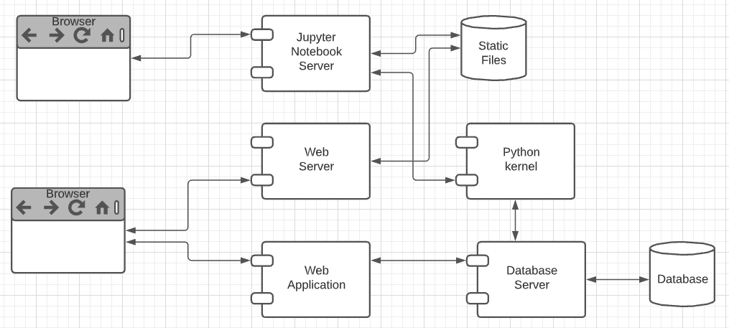
Harry Potter Character Information Application
Dataset:
https://www.kaggle.com/gulsahdemiryurek/harry-potter-dataset
Six “comma separated value (CSV)” files. We will start with Characters.csv.
Tasks: (Both tasks start with importing and engineering the data.)
Build an interactive web application for create-retrieve-update-delete entries. The application must enforce semantic integrity.
Build a Jupyter Notebook that does some interesting visualization and analysis.
Elements:
Content/applications in a browser.
Jupyter Notebook Server is both:
A web server
A (specialized) web application server.
Web server delivers HTML, images, ... to the browser.
Web application server executes an
Application server framework (Flask)
The Python code implementing the app.
The Jupyter Notebook Server runs code cells in a Python kernel.
I am mostly going to ignore the browser and content.

Slide 114
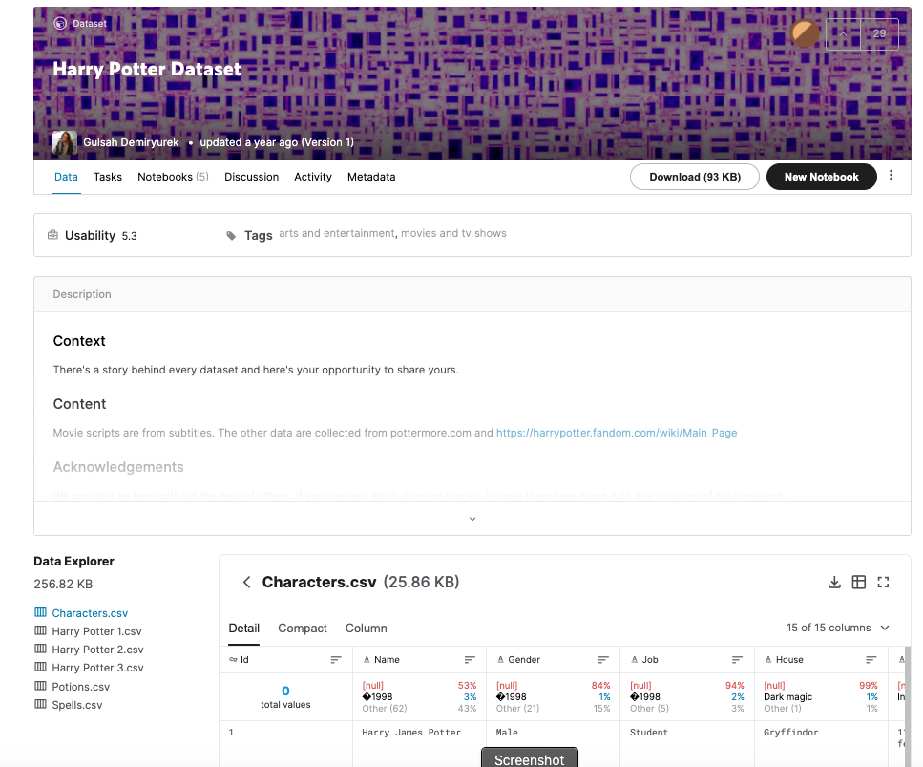
The Data – Characters.csv
15 columns:
Id
Name
Gender
Job
House
Wand
Patronus
Species
Blood status
Hair colour
Eye colour
Loyalty
Skills
Birth
Death
Downloaded the file.
The columns are separated by ‘;’
Despite being “Comma” Separated Values, other separators are common.
Loaded using DataGrip into MySQL
Connect
Create Schema
Use Schema
Use the data load tool.

Slide 115
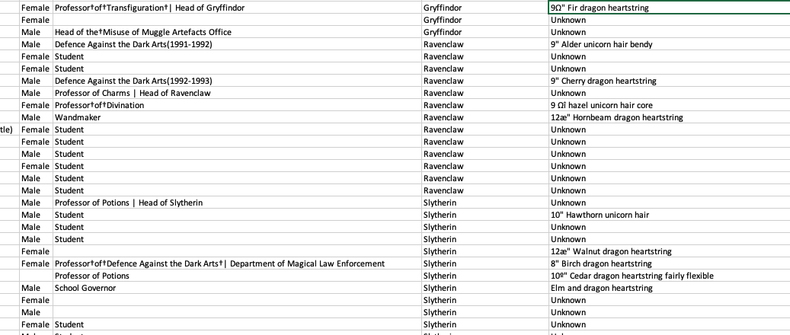
But First, Let’s Look at the Data
There are some weird characters, no pun intended.
9º" Chestnut dragon heartstring
Dumbledore's Army |Hogwarts School of Witchcraft and Wizardry
9Ω" Fir dragon heartstring
Professor†of†Transfiguration†| Head of Gryffindor
How did this happen?
What do we do?

Slide 116
Analysis (I)
Some of the issues are character encoding/set issues:
“In computing, data storage, and data transmission, character encoding is used to represent a repertoire of characters by some kind of encoding system that assigns a number to each character for digital representation.” (https://en.wikipedia.org/wiki/Character_encoding)
“A character set is a collection of characters that might be used by multiple languages.” (https://en.wikipedia.org/wiki/Character_encoding)
This will be a common issue when dealing with string data that you import to build your database.
This is especially true if the data comes from “data scraping”.
“Data scraping is a technique in which a computer program extracts data from human-readable output coming from another program.” (https://en.wikipedia.org/wiki/Data_scraping)
There are several types of scraping: screen scraping, web scraping, ... ...
That is what happened here. The data comes from web scraping a wiki page.

Slide 117
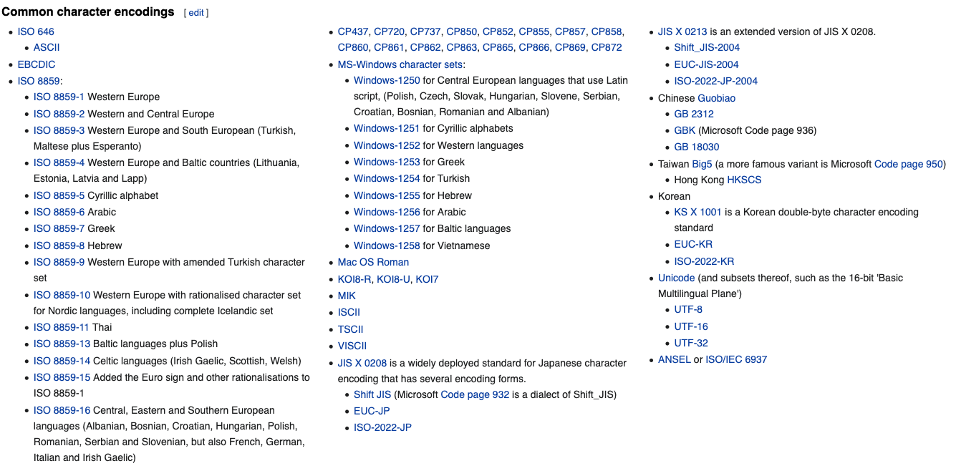
Character Encodings/Character Sets

Slide 118
Character Set Usage over Time
https://www.w3.org/International/questions/qa-who-uses-unicode

Slide 119
But, ... ...
Consider Job column entry: “Professor†of†Transfiguration†| Head of Gryffindor”
There are two odd characters: “†” and “|”
How should I correct/interpret the strings? My interpretation is:
Replace “†” with “ “.
The “|” means that the person has two jobs:
Professor of Transfiguration
Head of Gryffindor
The Job column is a multivalued attribute.
The character “|” indicates that a text string is one string containing multiple values for an attribute.
Can I always replace non-|, odd characters with “ “?
‘9Ω" Fir dragon heartstring’ and ‘9º" Chestnut dragon heartstring’ would wind up having an extra space. I want 9”, not 9 “.
The cleanup is getting complicated.

Slide 120
The Cleanup is Rule-Based
In this dataset, I can use a set of rules for data clean up:
Two characters separated by † maps to two characters separated by “ “ (space).
A number and “ separated by an odd character maps the the number and “
Strings of the form s1 | s2 | s3 maps to [s1, s2, s3]
etc.
Well, I could write a custom function for each rule,
But what happens when I find I need other rules.
It would be nice if there were some kind of tools that helps.
A regular expression is a sequence of characters that define a search pattern. Usually, such patterns are used by string-searching algorithms for "find" or "find and replace" operations on strings, or for input validation. It is a technique developed in theoretical computer science and formal language theory. (https://en.wikipedia.org/wiki/Regular_expression)

Slide 121
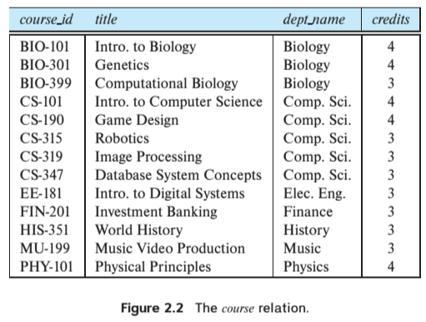
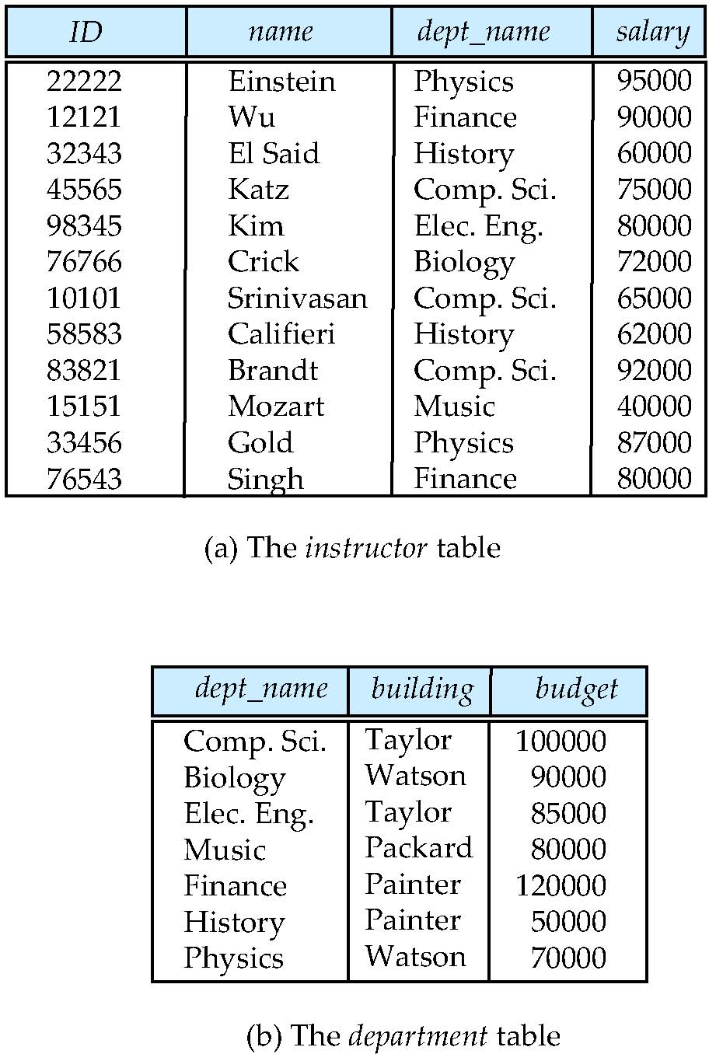
Multivalued Attributes
How about strings of the form s1 | s2 | s3 maps to [s1, s2, s3]. Is this cool?
All the data entity sets we have seen have had simple types/value attributes. Depends on the database model, e.g. relational, document, ...

Slide 122
Data Cleansing
https://blog.amplitude.com/big-data-cleanup
Database and data science classes love to teach the fun stuff queries, data modeling, machine learning, spooky math, algorithms, ... ...

Slide 123
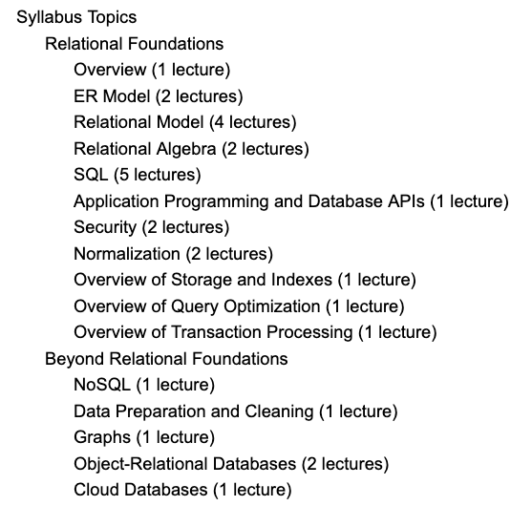
Data Cleansing
Recommended Syllabus
I place more emphasis on data cleansing and refactoring than other sections of W4111.

Slide 124
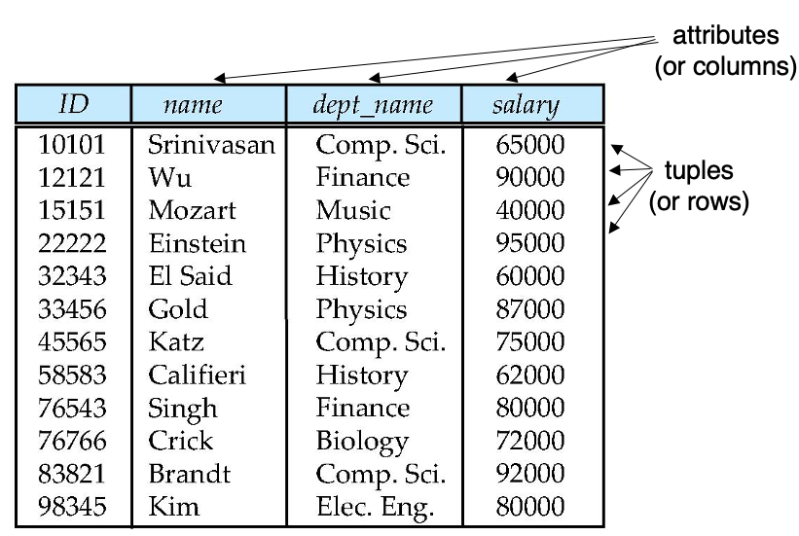
Next Steps in the Plan
Source Data
Relational Data
We are starting the semester with the relational datamodel/databases.
Before we get too far in our data janitor work, we should understand the relational model a little more.

Slide 125
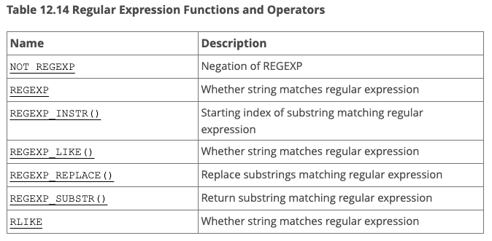
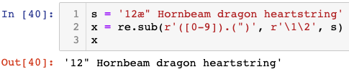
But, Before We Leave ... ...
What are these regular expressions whereout you speak?
Many environments come with regular expressions functions for searching and transforming strings.
Python: Lib/re.py (https://docs.python.org/3/library/re.html)
Java: java.util.regex (https://www.w3schools.com/java/java_regex.asp)
"SNOBOL ("StriNg Oriented and symBOlic Language") is a series of programming languages ... ... having patterns as a first-class data type.” (https://en.wikipedia.org/wiki/SNOBOL)
Most SQL databases have some from of regular expression library, but the libraries differ from product to product.
This was FYI.
Not a core part of W4111.
We will play with it a little.

Slide 126
Today’s Task #1 I did the set up and provided the tools, but did not do the task. I will cover in a recitation.
126 | COMS W4111_002_2021_1: Lecture 2: ER, Relational, SQL (II) © Donald F. Ferguson, 2021

Slide 127
Harry Potter Character Information Application (Reminder)
Dataset:
https://www.kaggle.com/gulsahdemiryurek/harry-potter-dataset
Six “comma separated value (CSV)” files. We will start with Characters.csv.
Tasks: (Both tasks start with importing and engineering the data.)
Build an interactive web application for create-retrieve-update-delete entries. The application must enforce semantic integrity.
Build a Jupyter Notebook that does some interesting visualization and analysis.
Elements:
Content/applications in a browser.
Jupyter Notebook Server is both:
A web server
A (specialized) web application server.
Web server delivers HTML, images, ... to the browser.
Web application server executes an
Application server framework (Flask)
The Python code implementing the app.
The Jupyter Notebook Server runs code cells in a Python kernel.
I am mostly going to ignore the browser and content.

Slide 128
Next Steps in the Plan
Source Data
Relational Data
We are starting the semester with the relational datamodel/databases.
Before we get too far in our data janitor work, we should understand the relational model a little more.

Slide 129
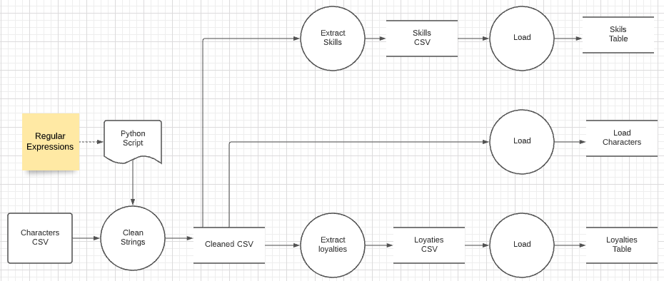
Data Flow
I downloaded the Harry Potter character set CSV file.
I had two cleanup problems.
The file contains some weird characters in strings, e.g. “9Ω" Fir dragon heartstring
There is a one-to-many relationship in columns marked with delimiters, e.g. Professor†of†Transfiguration†| Head of Gryffindor
I wrote a little Extract-Transform-Load (ETL) process. We will cover ETL in Module IV in the final part of the semester.
The next steps are to clean up the data in the RDB.

